Slide 1


CUSTOMER REFERENCE
WEBINAR
Notes:
Changed picture

Slide 2




TODAY’S CUSTOMER WEBINAR
PANEL DISCUSSION
GUEST CUSTOMER
ERP JOURNEY

Slide 3

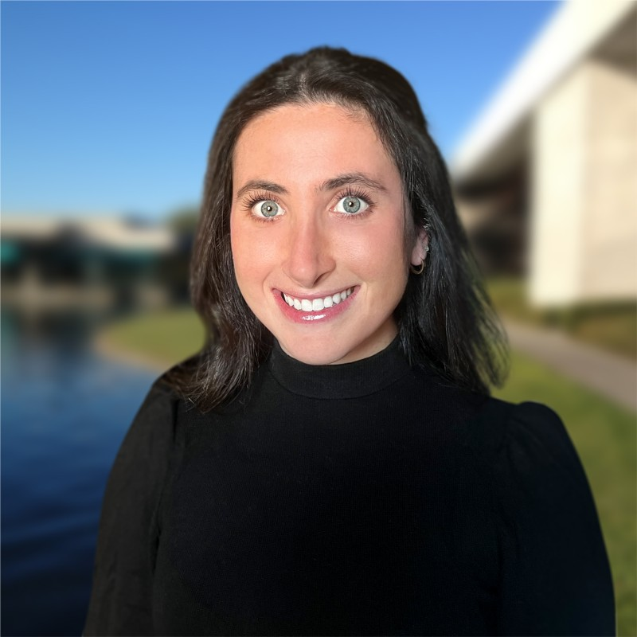
SPEAKER PANEL
Dan Wolf, Dir. Information Technology, Gachina
Dan has been with Gachina since 2017, as the Director of IT. With an MS in Mechanical Engineering Controls and Manufacturing from San Jose State University and a BS in Mechanical Engineering from Cal Poly San Luis Obispo, Dan has over 25 years of experience in the semiconductor, medical, and education industries, and has been in IT and engineering operations management since 1997.
Caila Cohen, Partner, Caravel
Caila heads up Caravel's Solution Engineering team and works with clients in all stages of their system lifecycle - evaluation, implementation, support and optimization.
Caila is an Engineer by trade but spent many years implementing NetSuite for various types of organizations across verticals.

Slide 4


ABOUT CARAVEL

Slide 5
ABOUT Gachina Landscape Management
INDUSTRY | Commercial and Estate Landscape Management
BUSINESS
DESCRIPTION | Gachina manages client landscape assets through regenerative solutions, plant health care programs, smart water management practices, and strategic future planning.
EMPLOYEES | 367
HEADQUARTERS | Menlo Park, CA

Slide 6
ERP JOURNEY
SYSTEMS
Great Plains
Aspire
ADP
Jitterbit
HubSpot
MS SQL
Power BI
GoCanvas
Azuga
PropertyIntel
BUSINESS PAINS
Previous ERP being phased out
GP system difficult to work, not flexible or efficient
Planning and Budgeting was done in Excel, very time- consuming and difficult to manage
AR ageing was too high, needed better way of managing AR
Needed an ERP which could scale with business growth
ERP GOALS
Improve Planning and Budgeting with ERP integrated system
Improve AR ageing
PO workflow process
Improve accounting teams processes, more efficient
System to go paperless
PRE-NETSUITE
POST-NETSUITE

Slide 7
SELECTION PROCESS
VENDORS CONSIDERED
  NetSuite
  Sage
  Accumatica
  MS Dynamics
PROCESS
  Spoke with landscape industry experts who also use Aspire
  Involved external financial business experts
  Reviewed ERP demos with implementation teams fully engaged in the process, helping to understand our business needs
  Spoke with ERP references
  Negotiated best price for preferred ERP platform
DECISION CRITERIA
  Used a decision matrix, scoring the ERP platforms
  System needed to have ability to address our pains and meet our goals
  Needed to have confidence in the implementation team

Slide 8
“WHO” & “WHY”
WHO & WHY NETSUITE
    NetSuite was the clear winner
    The Dunning module for collections was an attractive sell for us
    NetSuite was an intuitive GUI, which we felt would be easier to learn
    The already integrated Planning and Budgeting had the flexibility we needed for our business
    NetSuite was the most scalable solution
    NetSuite was highly recommended by our financial business experts
WHO & WHY CARAVEL
    Caravel was highly recommended by our financial business experts
    Caravel demonstrated competence in their ability to understand our business needs and work with NetSuite to provide a solution
    Caravel project manager had controller level experience
    References ERP implementations went well

Slide 9



ERP BENEFITS
FOUNDATION
Platform for growth
LEADING PRACTICES
Adopt leading practices & controls
VISIBILITY
Timely access to data & improved reporting

Slide 10


IT’S A WRAP!
UPCOMING WEBINARS
Caravel Contacts
Tai Valenzuela, Managing Director,
Delivery & Operations
tvalenzuela@bpm.com
Meagan Hove, Director, Client Engagement
mhove@bpm.com
9/26 P. W. Gillibrand
10/30 InSource Customer Reference Webinar
Q&A

Slide 11
Thanks!

