Slide 1



CUSTOMER REFERENCE
WEBINAR
Notes:
Changed picture

Slide 2



TODAY’S CUSTOMER WEBINAR
PANEL DISCUSSION
GUEST CUSTOMER
ERP JOURNEY

Slide 3
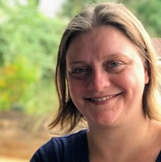
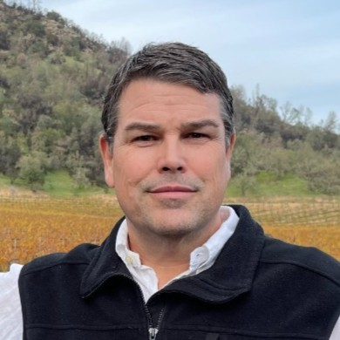
SPEAKER PANEL
Shanielle Wenzl, Dir. of Accounting
Shanielle had worked with Zinnia for 5 years as the Sr. Finance Manager. When she started with Zinnia, she was tasked with revamping the client invoicing and revenue recognition process. She built a team of 7 individuals within the US and India and implemented NetSuite to automate an extremely manual and tedious process. She was recently promoted to Director of Accounting and has been charged with building a new Financial Systems team to automate all processes for the Accounting and FP&A Teams. Prior to joining Zinnia, she was the Controller of MSE Audio where she managed the accounting and customer service teams and was the administrator for the accounting software Dynamics GP.
Scott Curry, Managing Partner
Scott works with clients on business process strategy, software selection, implementation and managed services. As a former CPA and Financial Operations Principal, Scott has a broad background including finance, distribution, manufacturing, eCommerce, CRM and HCM. Scott works with various software, high-tech manufacturing, semiconductor, renewable energy, retail, multi-channel distribution, services, consumer products, life sciences, gaming and social networking companies. Scott has held various positions in his career and worked directly for some of the world’s largest software companies such as Oracle and NetSuite.

Slide 4


ABOUT CARAVEL

Slide 5
ABOUT ZINNIA
INDUSTRY | High-tech
BUSINESS
DESCRIPTION | By merging decades of industry expertise with advanced technology, Zinnia seeks to transform the life and annuity experience from end-to-end. Zinnia will empower their clients to innovate and launch products faster, to buy, sell, manage, and service products more effectively, and to better serve their customers.
EMPLOYEES | 1,100+
HEADQUARTERS | Topeka, KS

Slide 6
ERP JOURNEY
EXISTING SYSTEMS
NetSuite
PeopleSoft
QuickBooks
Tally (India)
Zero (Canada)
Herbst Insight (Ireland)
BUSINESS PAINS
Disjointed systems across all subsidiaries
Lack of control over the individual systems
Manual and time-consuming process to upload data from individual source systems to consolidated ERP
ERP GOALS
One ERP for all subsidiaries to transact in, which was flexible enough to meet the individual subsidiaries needs while still maintaining solid internal controls
Reduce manual processes and create scalable automated processes
Ability to easily create consolidated financials to management for decision-making

Slide 7
SELECTION PROCESS
VENDORS CONSIDERED
NetSuite OneWorld
Dynamics GP
Oracle Cloud
PROCESS
Identified system requirements from each subsidiary; likes/dislikes from their current ERP
Created a score card for users to complete while watching each demo
Identify current source systems and determine which systems should integrate with the selected ERP.
DECISION CRITERIA
Multi-subsidiary and multi-currency functionality with the ability to consolidate at a parent level.
Robust reporting with the ability to modify as needed without the assistance of IT.
Has prebuilt integrations with
current source systems, i.e.
OpenAir, Expensify, Blackline.

Slide 8
“WHO” & “WHY”
WHO & WHY NETSUITE
    NetSuite OneWorld had the consolidation features we were looking for
    The NetSuite interface and functionality is easy to navigate for users with different technological abilities
    Able to integrate source systems easily using prebuilt integrations
WHO & WHY CARAVEL
    Recommended by NetSuite as a preferred partner with experience in India localization
    Detailed project plan and robust tools to keep the project on track
    Very competitive pricing and timeline for implementation

Slide 9



ERP BENEFITS
FOUNDATION
Platform for growth
LEADING PRACTICES
Adopt leading practices & controls
VISIBILITY
Timely access to data & improved reporting

Slide 10


IT’S A WRAP!
Upcoming Caravel Webinars
4/18 Healthcare Succeeding in NetSuite with Encodia
4/25 Field Service Succeeding in NetSuite with Leaf Home
5/02 How a Large Organization Migrated to NetSuite with Curalta
5/09 Delivering on Large NetSuite Implementations with United Road
Caravel Contacts
Tai Valenzuela, Director, BPM Advisory
tvalenzuela@bpm.com
Meagan Hove, Director, Client Engagement
mhove@bpm.com
Q&A

Slide 11
Thanks!

